Slide 1


Controller setup
Lucas Weaver

Slide 2


Required Components
Raspberry Pi
MPU6500 sensor
Breadboard
Wires
(All should be supplied in the kit)

Slide 3
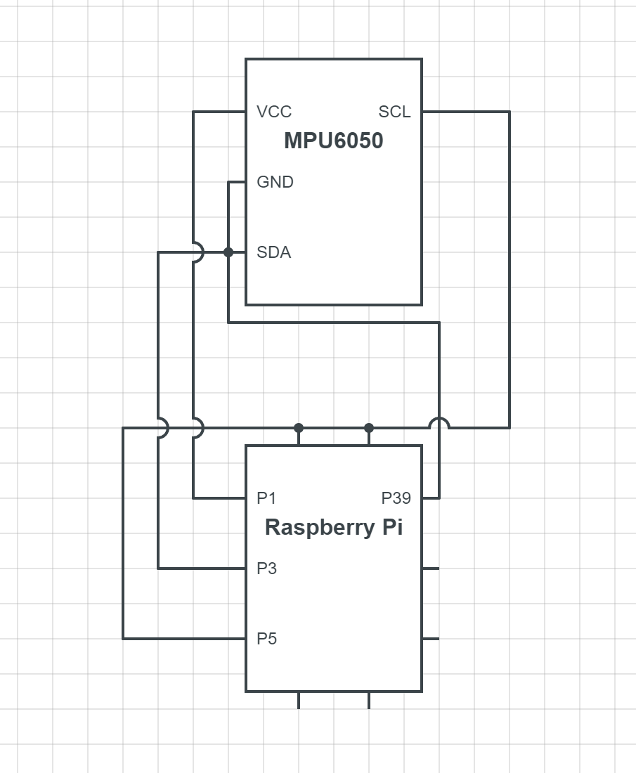
Circuit diagram

Slide 4
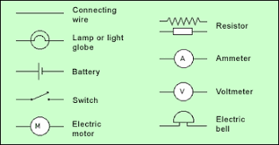
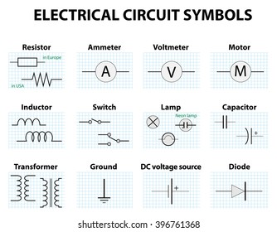
How to Read circuit diagrams
The only important symbol as of now is the line displaying a connected element between the two components.
The Raspberry Pi when turned on gives the needed batteries and ground.
For more in depth explanation visit: https://learn.sparkfun.com/tutorials/how-to-read-a-schematic/all

Slide 5
Connected Circuit
Add a picture of the circuit done by hand

Slide 6
How to test if the device is connected?
Create a test to fully check if the device is connected in window and linux…

Slide 7
Background: How do components communicate?
Communication between hardware and your computer and get very complicated very fast. To standardize and simplify tested processes they created standard protocols. The most common found in sensors is I2C, SPI, UART.
This project utilizes I2C. If you’d like to learn more about the basics of I2C you can read it here: https://www.circuitbasics.com/basics-of-the-i2c-communication-protocol/

